Slide 1
COVID-19: Google Searches for Symptoms
Christopher Shaffer
https://github.com/chrisshaffer/covid-symptom-searches

Slide 2

Study Goal
Predicting spread of COVID-19 early is useful for:
Hospitals
Governments
Are increasing symptom searches correlated with an increase in new COVID-19 hospitalizations?
What is the delay between searches and hospitalization?

Slide 3
Data Sources
COVID-19 Open Data by Google*
Hospital data compiled from hospital/government records
Symptom searches from Google Trends
*O. Wahltinez and others, "COVID-19 Open-Data: curating a fine-grained, global-scale data repository for SARS-CoV-2” https://goo.gle/covid-19-open-data, (2020)

Slide 4
Exploratory Data Analysis

Slide 5
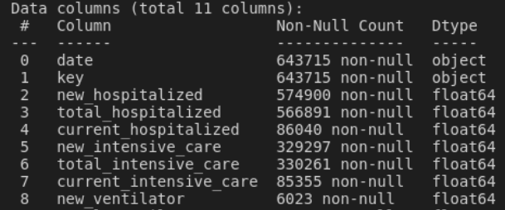
Data Structure
Hospital Summary
Main tables:
Hospitalization data
Dimensions: (643 715, 11)
Symptom Google search popularity
Dimensions: (1 425 194, 450)
Dates and locations for each entry
Null values for missing or small data

Slide 6
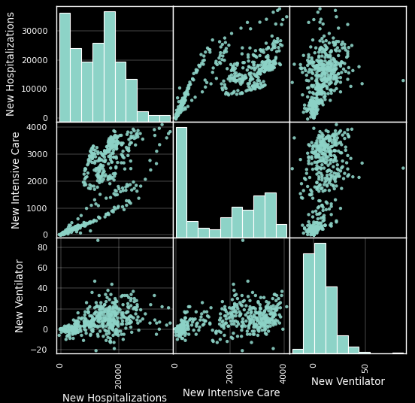
Hospitalization Data
Change per day
Aggregated globally
Non-normal distributions
Columns are correlated

Slide 7
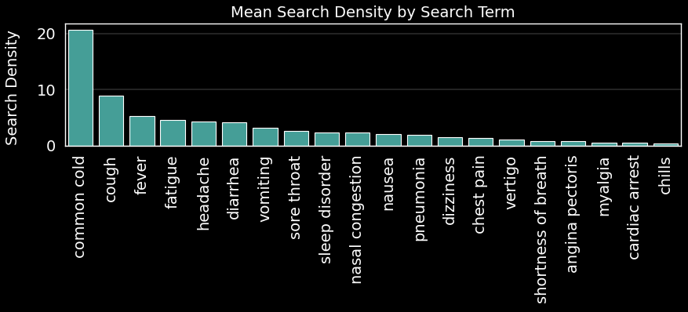
Search Term Popularity
Only symptoms of COVID-19
Sorted by popularity
Relative search term popularity
Normalized by day and region

Slide 8
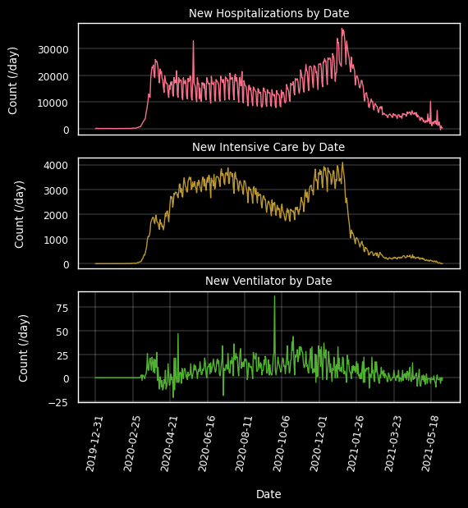
Hospital Time Series Data
New Hospitalizations rise
Data correlated with time
Cannot assume i.i.d.
New hospitalizations begin to rise in early March 2020

Slide 9
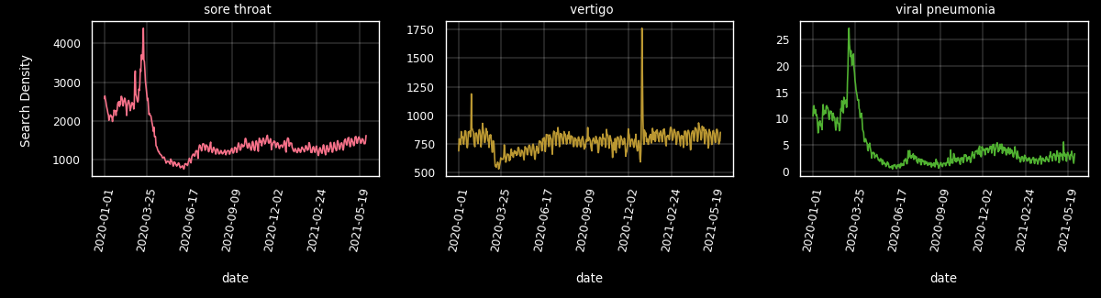
Search Density Time Series
Searches appear correlated with COVID-19 hospitalizations
Delay between searches and hospitalizations
Searches begin to increase in Feb 2020
Searches rise

Slide 10
Hypothesis Testing

Slide 11
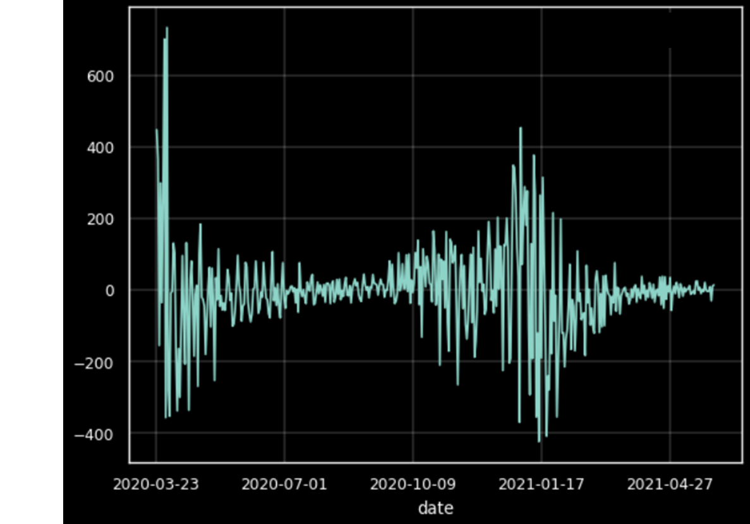

Independent and Identically Distributed (i.i.d.)
Issue: Time series data not i.i.d.
Calculate daily changes ($Δ$)
Naïve residuals method: $r_{t}=x_{t}−{\hat{x}}_{t}=x_{t}−x_{t−1}$

Slide 12
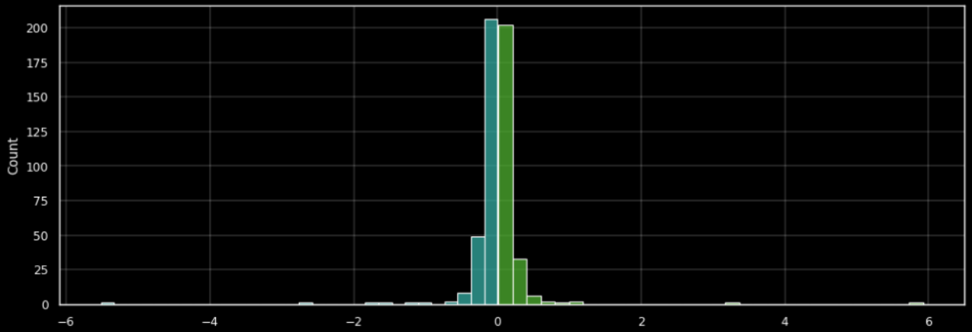

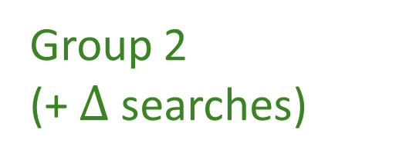


Hypothesis
H₀: $μ_{1}=μ_{2}$
$μ$is Mean($Δ$ new hospitalizations)
Group 2
(- $Δ$ searches)
Group 2
(+ $Δ$ searches)
$Δ$sore throat searches (/day)

Slide 13
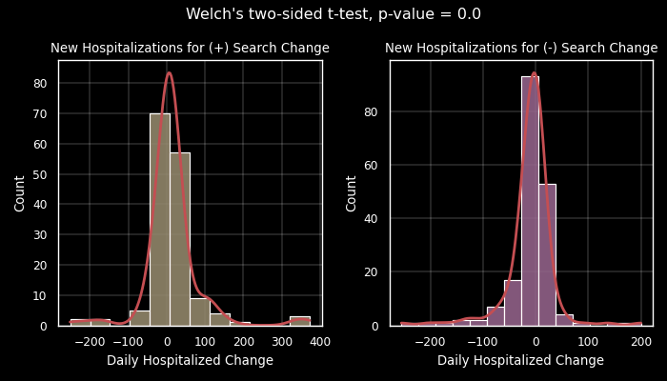

Hypothesis Test
$τ=2$ weeks, Location: New York City, Search Term: “fever”
Δ
Δ

Slide 14
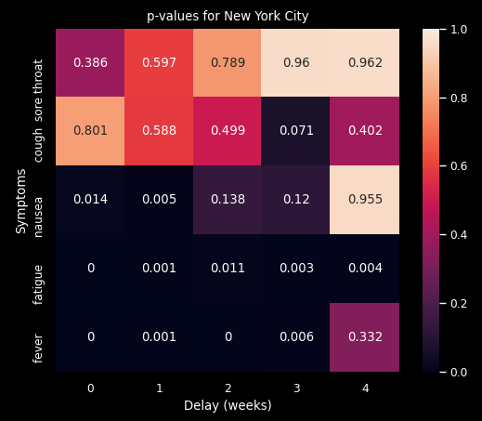
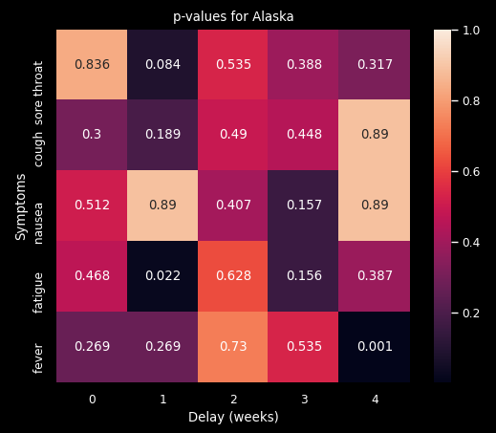
p-value Distributions for NYC and AK
*
* Trend is wrong direction

Slide 15
Future Work
Single sided p-test
Refine time shift spacing
Explore more locations and symptoms

Slide 16
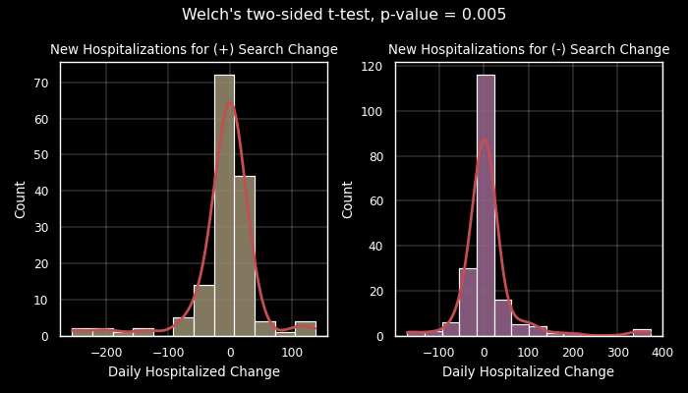
Extra Slide
Nausea NYC delay = 1 week

